Slide 1
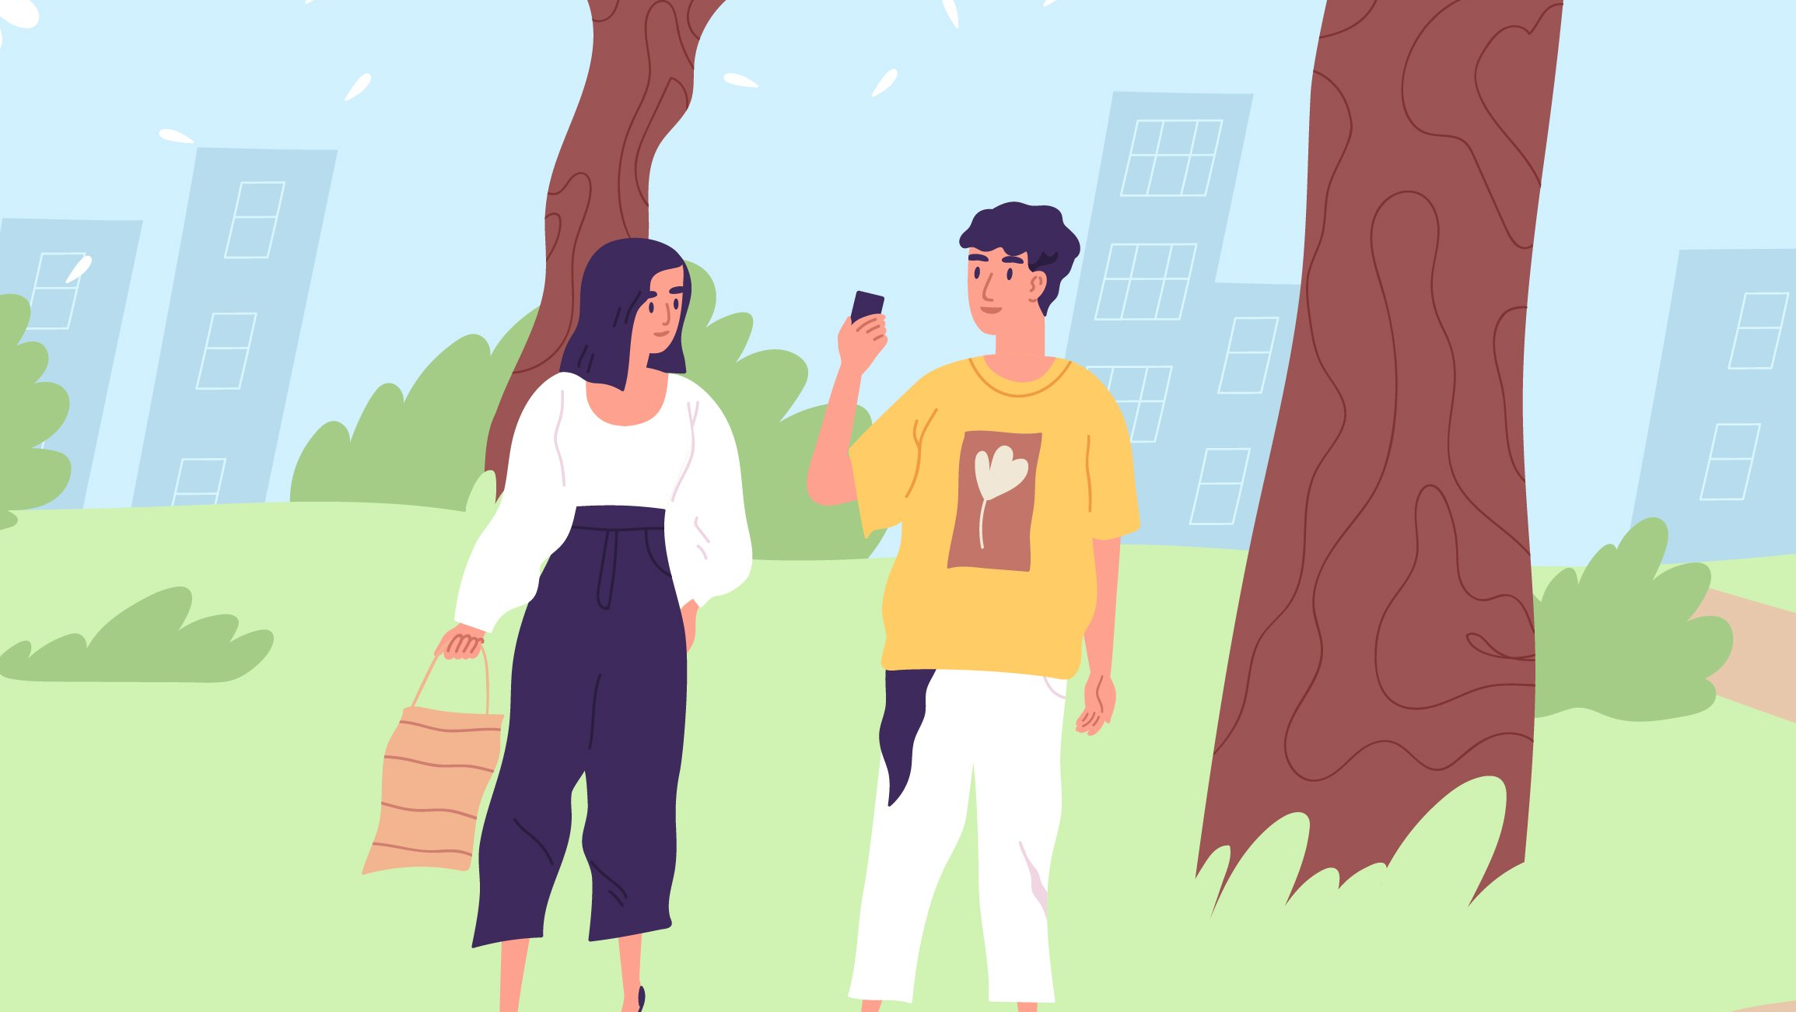
Walk & Talk
Tom van Hoesel Ramon Salah Tar van Krieken

Slide 2
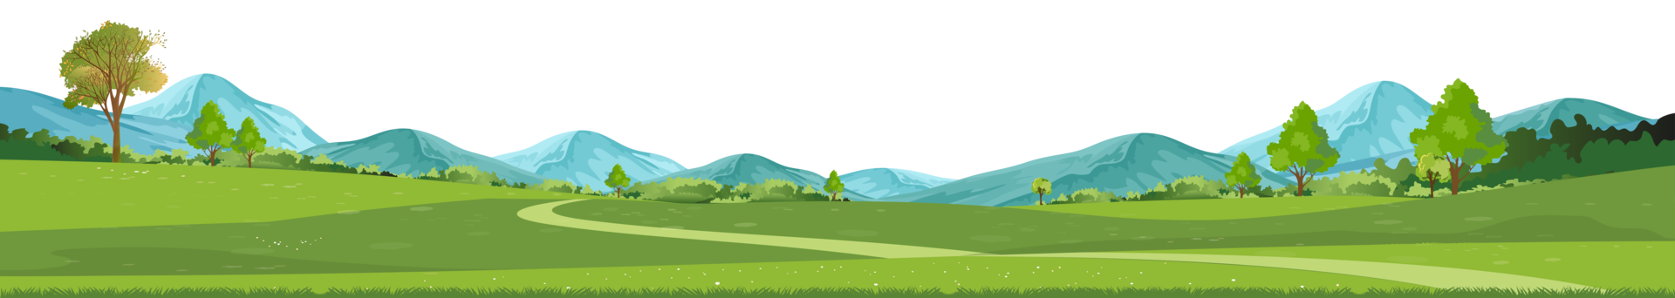
The problem
Loss is a first-time experience for the bereaved and their peers, and both have their own difficulties:
Bereaved
Actively engage in grieving in a healthy way
Start conversations with their peers
Their peers
Never had to support their friend in this way
Lacks confidence in asking the right questions

Slide 3
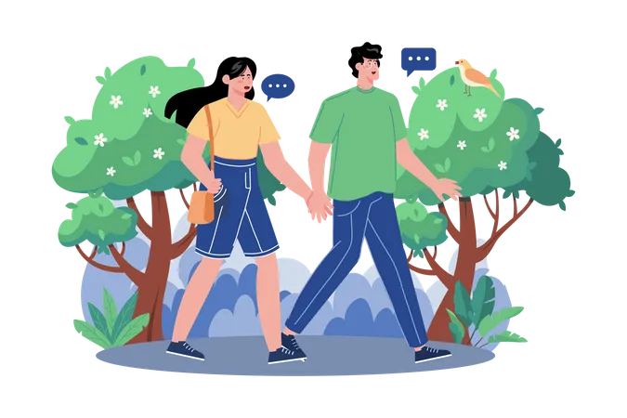
The application’s intentions
Unburden the bereaved as much as possible in starting conversations
Supporting difficult conversations between the bereaved and their peers
Used as aid for face-to-face interactions, not replacing them
Getting physically active in nature

Slide 4
Prototype: explaining the features
Bereaved view
Uploading memories to journal
Grieving by actively engaging with memories
Create a timeline you can “walk through” a memory lane
Ending up with a memorial full of old and new memories
Buddy view
Getting reminded to check up on bereaved
Getting conversation tips based on CBT and conversation topics based on memories
Sharing media with bereaved for journal

Slide 5
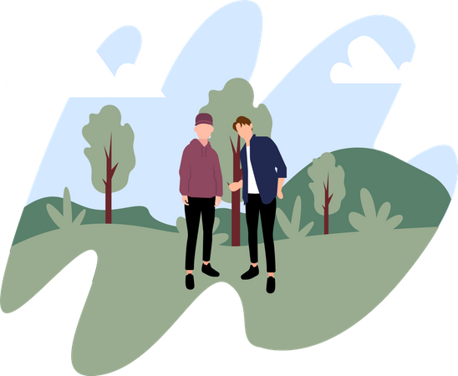
Tailored towards adolescents
Virtual journal using a variety of media
Popularity of walking as an activity
Supporting novel grief conversations
Relieving pressures
“Am I bothering my friends?”
“What questions should I ask?”

Slide 6
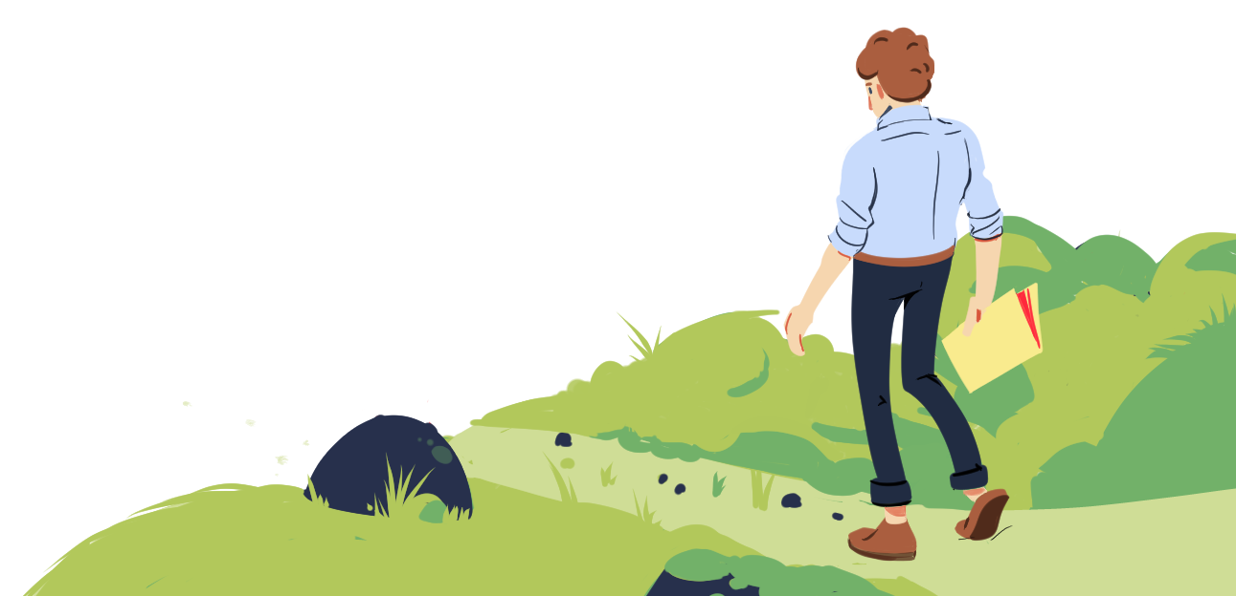
Physical activity supports grief outcomes (Williams et al., 2021)
Walking facilitated…
…a sense of freedom
…expressing of emotions
…enhancing of social support
…creating closer family cohesion

Slide 7
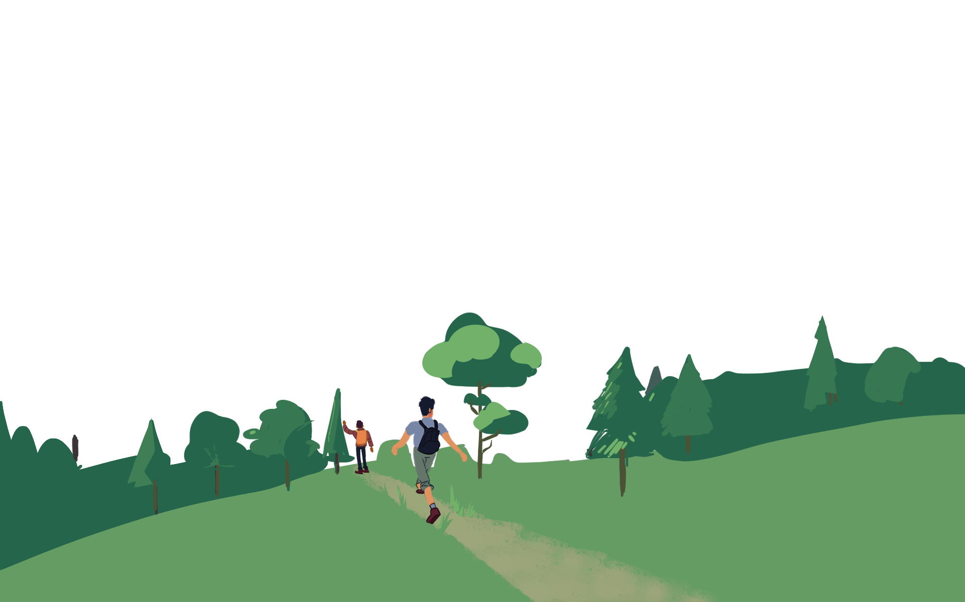
Benefits of being in nature
Being in nature can lower…
Stress
Anxiety
Depression
and improve…
Sleep
Presentness
Social connection

Slide 8
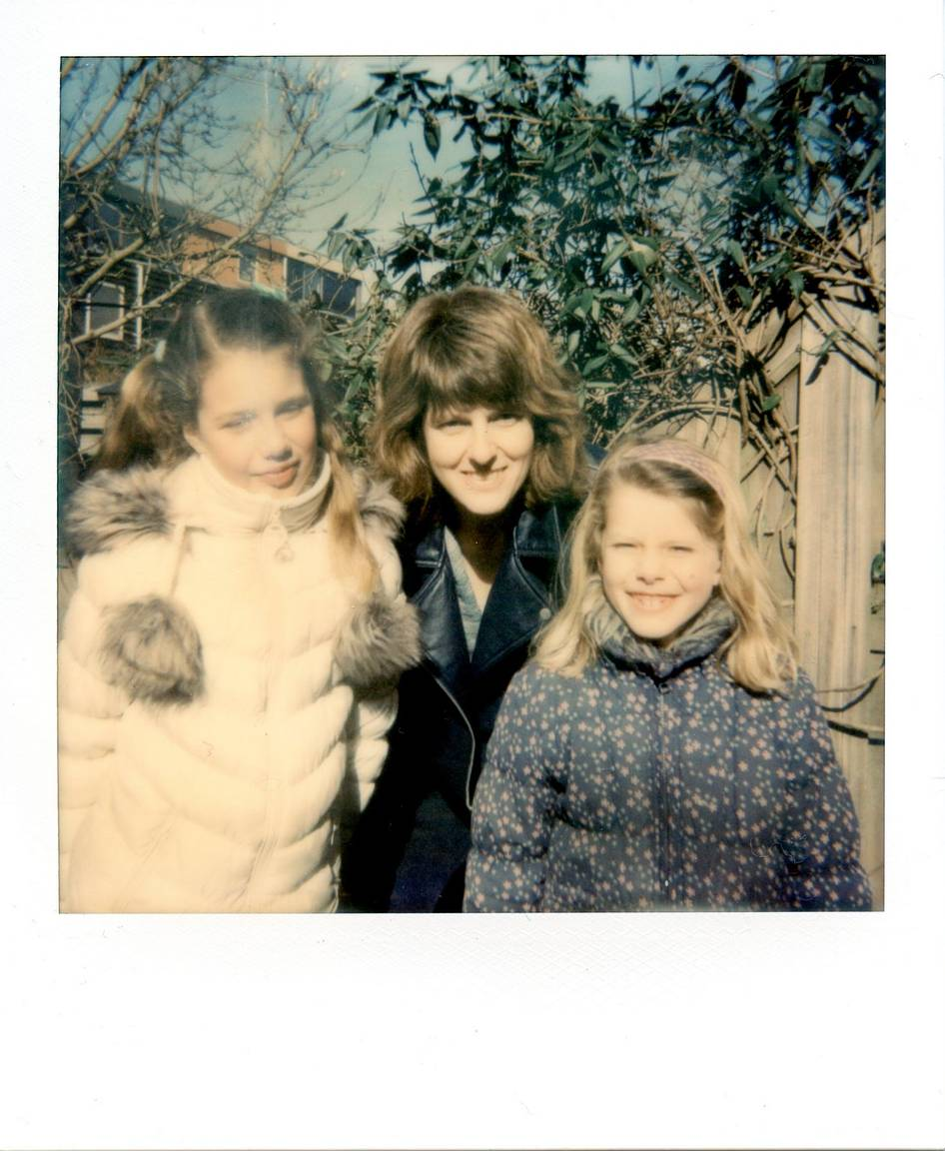
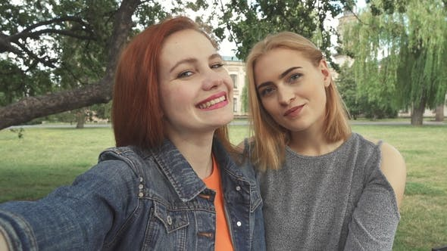
Reliving old memories…
…while making new ones.

Slide 9
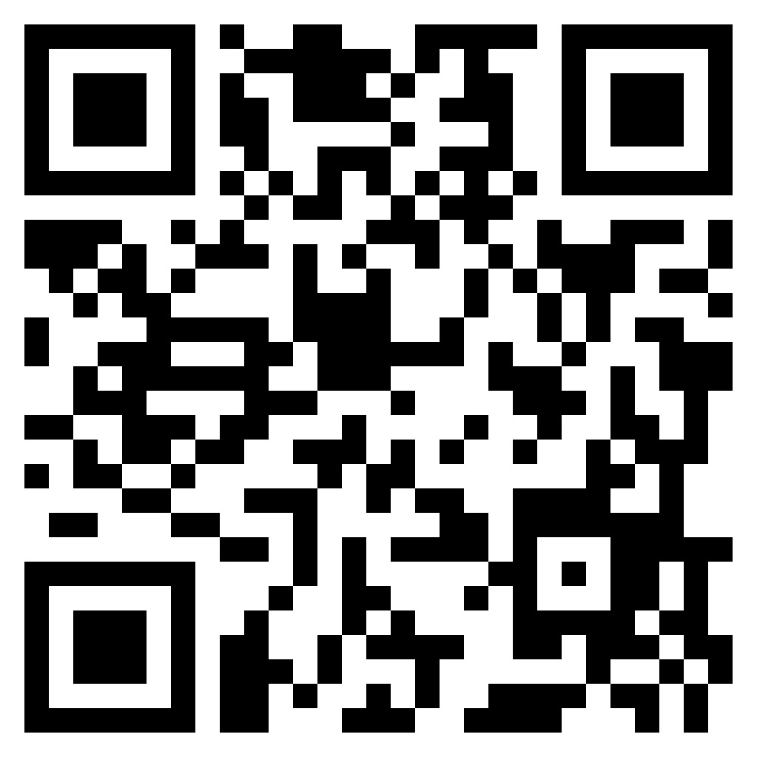
Try it yourself: https://tarvk.github.io/WalkAndTalk/build/#/phone//

Slide 10
Walk & Talk
Tom van Hoesel Ramon Salah Tar van Krieken

Slide 11

Implementation: two options
Server-based
Local
Ease of journal sharing
Sending invitations to friends
Check-up reminders
Privacy
Hack-proof
Cheaper

Slide 12
Design considerations
Tips while walking instead of preparing the conversation beforehand
No walking route choice / recommendations / map
No gamification aspects
Adding new memories to the journal
Educating the buddy as an addition to merely talking about the memory

Slide 13
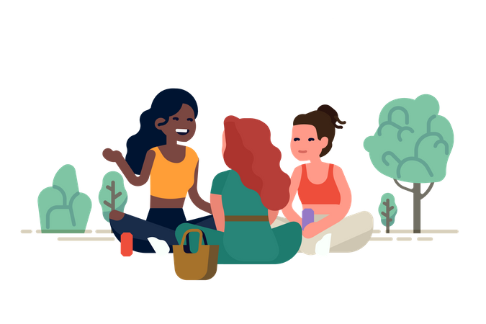
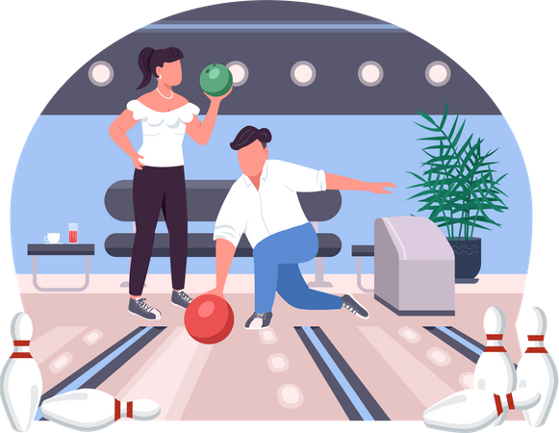
Context not set in stone

Slide 14
References
Williams, J., Shorter, G.W., Howlett, N. et al. Can Physical Activity Support Grief Outcomes in Individuals Who Have Been Bereaved? A Systematic Review. Sports Med - Open 7, 26 (2021). https://doi.org/10.1186/s40798-021-00311-z

